Slide 1

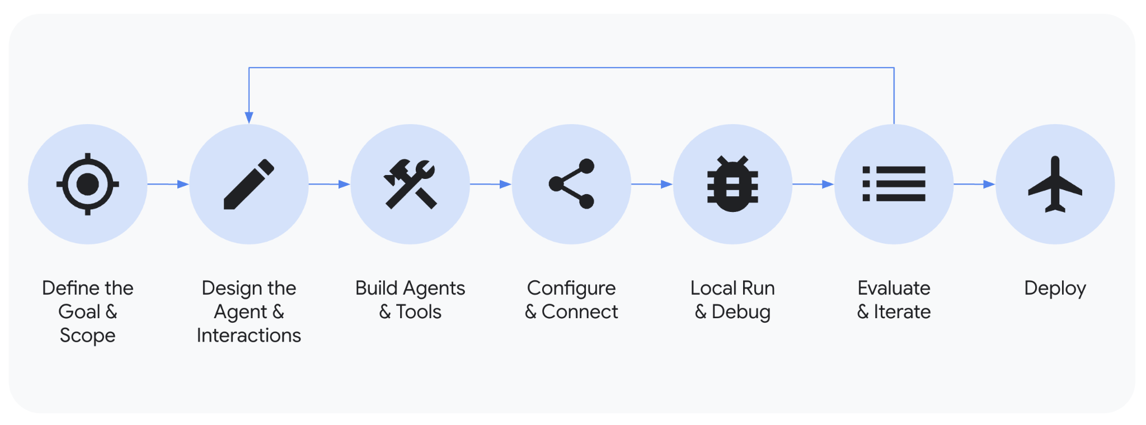
You need a process…
Esra
Notes:
A fast, controllable, easy-to-integrate way to build AI agents without getting bogged down.
ADK - The code-first Python framework for rapid agent prototyping & building.

Slide 2




the right stack…
Esra
Open-source, code-first toolkit for building, evaluating, and deploying AI agents.
Agent Development Kit
Open protocol that standardizes how applications provide context to LLMs.
Model Context Protocol
Managed platform to deploy, manage, and scale AI agents in production.
Vertex AI Agent Engine
Agent2Agent (A2A) protocol
Open standard designed to enable communication
& collaboration between AI agents.

Slide 3
And tips & tricks!
Esra
🎮
🎙️
How to make the most of
the Dev day?
What to present ?

Slide 4
Esra
How to make the most of Dev day?

Slide 5
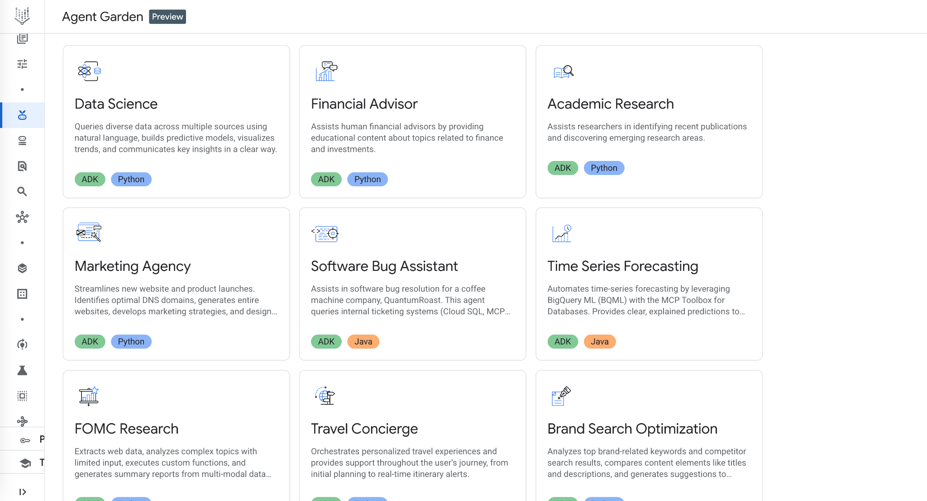
Tip #0: Don't reinvent the wheel!

Slide 6
A clean structure enables parallel work, easy debugging, and scalability.
your_agent_project/
├── your_agent_name/
│ ├── __init__.py
│ ├── agent.py # <-- Defines the main Orchestrator Agent
│ ├── prompt.py # <-- The Orchestrator's prompt
│ ├── shared_libraries/ # <-- Callbacks, Entities
│ └── sub_agents/ # <-- Each specialist agent gets its own folder
│ └── specialist_one/
│ ├── agent.py
│ └── prompt.py
├── deployment/ # <-- Agent Engine deployment scripts
├── eval/ # <-- Agent Evaluator tests
├── tests/ # <-- Unit tests
└── pyproject.toml

Slide 7

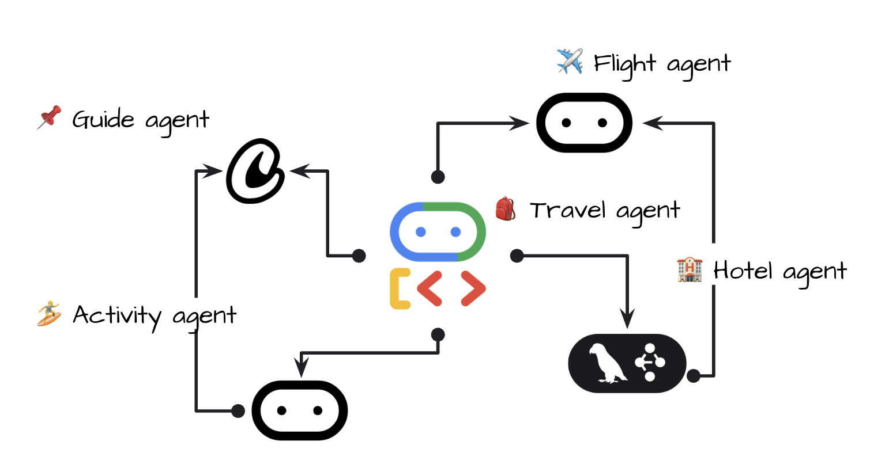
Tip #1: Don't Build an Agent, Build a System
Esra
Monolithic 👎
Modular 👍
Notes:
The Winning Edge Isn't a Better Prompt, It's a Better Architecture
Any team can write a prompt. A winning team designs a system. We will architect a system of collaborating specialists for your specific ideas.
Common Approach: A single, monolithic agent trying to do everything.
Problem: Becomes brittle, hard to debug, and its prompt becomes a huge, unmaintainable mess.
Your Winning Approach: A multi-agent architecture where each agent has one specific, well-defined job.
Benefit: Modularity, reusability, and far greater reliability.
Today, we're applying proven, advanced patterns to your agent concepts to give you a decisive edge.

Slide 8
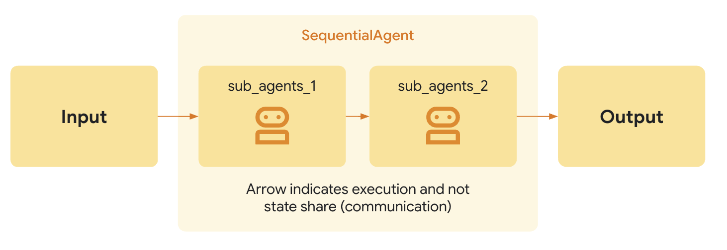
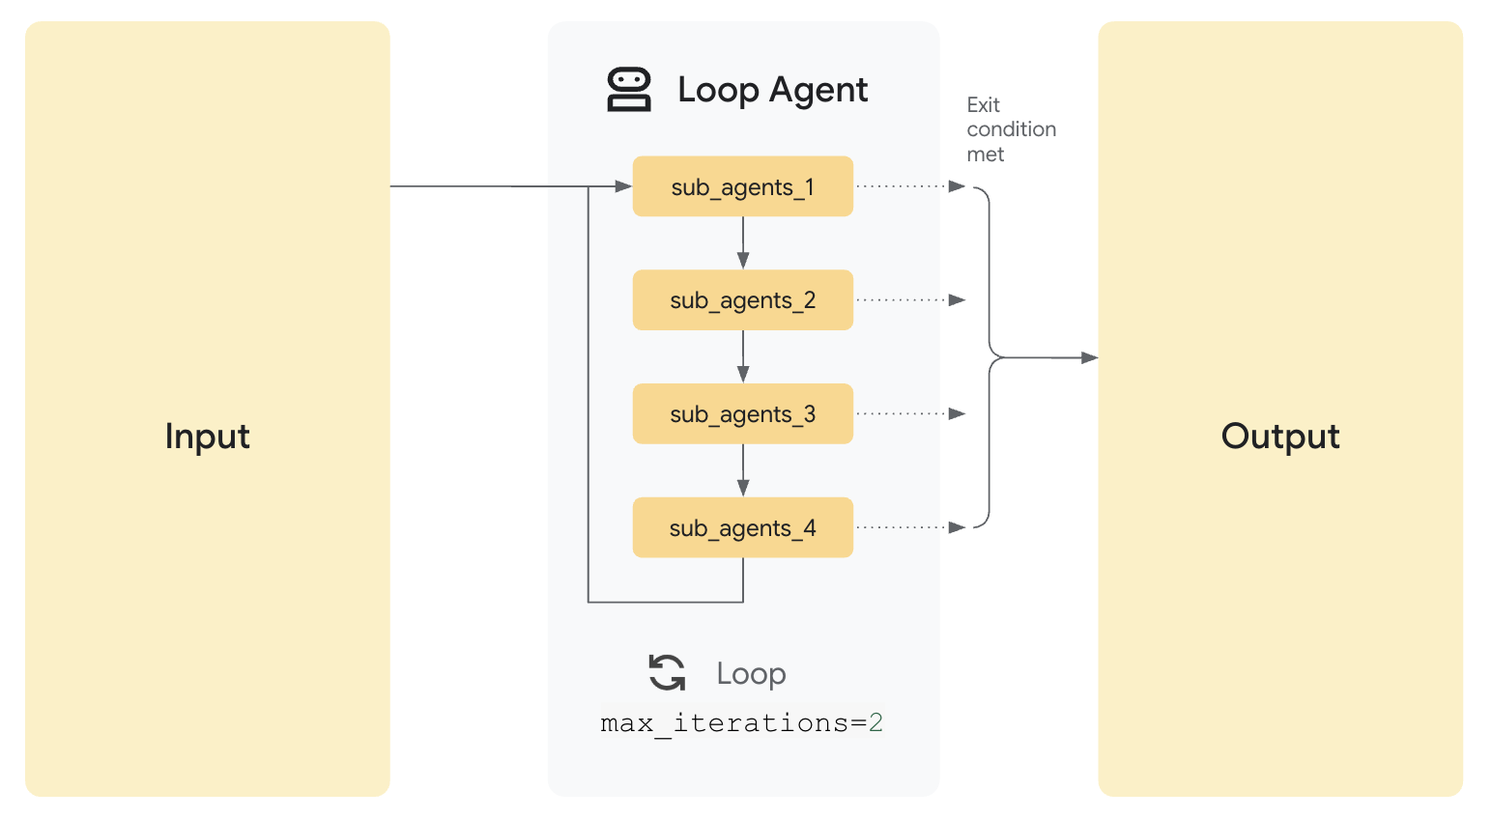
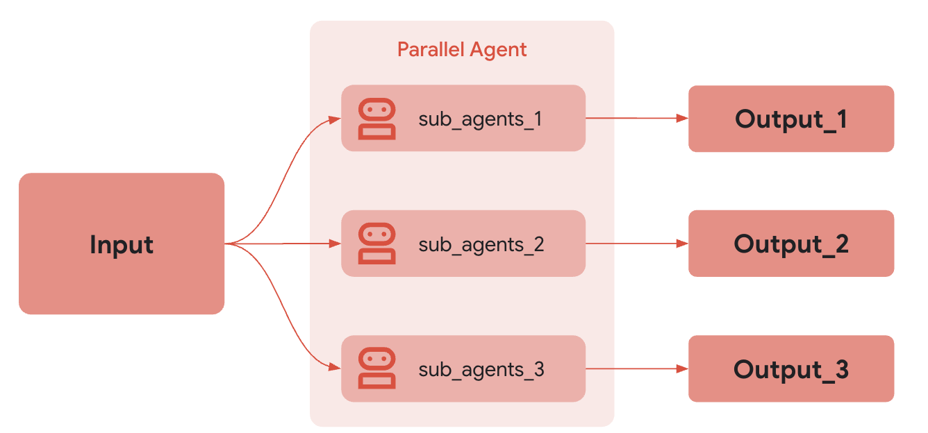
Tip #2: Don't just build agents, delegate!
Esra

Slide 9
Tip #2: Don't just build agents, delegate!
Esra
SequentialAgent: For processes where order matters. (A -> B -> C)
Use Case: "Know What You Don't Know" Diagnostic Agent
A diagnostic agent asks adaptive questions → Analyzes the correct/incorrect responses → Generates a "Next Best Study Plan" tailored to the learner's weak areas.
ParallelAgent: For gathering information simultaneously. (A & B happen at the same time)
Use Case: "Create anywhere" Omnipresent Experience.
When a user highlights text, an Intent Router and Tool Executor work to simultaneously suggest multiple actions like 'Explain', 'Make 5 cards', and 'Quiz me'.
LoopAgent:For iterating over a set of items.
Use Case: "Challenge Me" Adaptive Difficulty Agent.
The agent runs a performance loop: Monitors the learner's accuracy in real-time → If the learner gets 3 in a row correct, dynamically escalates the difficulty → If the learner "hits a wall," drops back to a review mode.

Slide 10
Tip #3: Your Best Tool is... Another Agent!
Esra
For the "Know What You Don't Know" Agent…
Your top-level Study Planning Agent doesn't know how to conduct a full diagnostic on its own. It doesn't need to.
It has access to a tool called run_diagnostic.
This "tool" is actually another complete agent: the Diagnostic Agent, which has its own conversational UI and function-calling tools to ask adaptive questions , score responses , and identify a learner's knowledge gaps.

Slide 11
Agent-as-a-tool example
# Simplified Example from the ADK
from adk.tools import tool
@tool
def run_diagnostic(subject: str, user_notes: str) -> dict:
"""Runs a diagnostic agent to identify a learner's knowledge gaps."""
# This function invokes your entire specialist 'Diagnostic Agent'
# It may use the student's notes as context
return diagnostic_agent.run(f"Run diagnostic for {subject} using notes: {user_notes}")

Slide 12
Agent-as-a-tool example
# Simplified example for your Quizlet Study Coach Agent
study_coach_agent = LlmAgent(
name="study_coach",
instruction="You are a helpful study coach. Your goal is to create a personalized study plan by first delegating to a diagnostic agent.",
tools=[
AgentTool(agent=DiagnosticAgent),
# You could also add the plan generation agent as a tool
# AgentTool(agent=PlanGeneratorAgent)
],
)

Slide 13
Tip #4: Structured prompts & error handling
Esra
Don't write a paragraph. Break your prompt into explicit sections like Role, Objective, and a step-by-step Procedure.
Explicitly tell the agent how to fail and ask for more information.
This is crucial for your Study Sprint Coach agents. If the user just says "I need to study," the agent must be prompted to fail and ask for the missing "available time" and "content scope" before it can build a plan.

Slide 14
Study Sprint Coach agent prompt
If available_time or subject are Missing:
You MUST NOT proceed.
Instead, you MUST formulate a response to ask the user for the missing goals.
Example: "I can definitely help with that! To build the best study sprint, I need to know two things: how much time do you have, and what subject are you studying for?"

Slide 15
Tip #5: One Agent's Output is a Draft.
A Second Agent Provides Quality Control.
Esra
For your ”Create Anywhere” agent:
A CardGeneratorAgent translates a user's highlighted text (e.g., "Krebs cycle" ) into a set of 5 draft flashcards.
A CardCriticAgent gets these "draft cards" and reviews them against a rubric:
"Are these cards factually accurate? Is the format a proper 'term' and 'definition'? Do they directly relate to the highlighted concept?"
The orchestrator loops until the critic approves, then shows the "draft cards" to the user to edit or add to their set

Slide 16
Trick #6:
Deterministic Guardrails via Callbacks
Esra
Use ADK's callback system to run deterministic checks before a tool is executed.
The before_tool callback intercepts a tool call before it runs.
"Create anywhere" Flashcard Generation:
The LLM suggests generating flashcards from a user's highlighted text.
Before the generate_cards tool runs, a before_tool callback executes a simple Python check. If len(highlighted_text) > 2000 , the callback intercepts the call, stops the tool, and returns a deterministic error: “The highlighted text is too long to generate cards from. Please select a shorter passage.”

Slide 17
Tool example
def before_tool(tool: BaseTool, args: Dict, ...):
if tool.name == "generate_cards":
# Get the highlighted text from the tool's arguments
text_input = args.get('highlighted_text', '')
# This is our deterministic guardrail check
if len(text_input) > 2000:
# This returns an error message to the LLM and stops the tool call!
return ""The highlighted text is too long to generate cards from. Please select a shorter passage."
return None # Proceed if tests pass

Slide 18
Trick #7:
Don't just find information, prove it’s correct.
Esra
This is perfect for your "Know What You Don't Know" Agent.
Use VertexAiRagRetrieval to connect your agent to a corpus containing the learner's "student notes".
Create a separate FactCheckAgent whose only job is to validate the "Next Best Study Plan" generated by the main agent.
Its prompt is: "Given the diagnostic results (e.g., 'weak on cell division') and the following retrieved 'student notes', is the proposed study plan factually supported by and correctly targeted to only the identified weak areas? Answer 'Yes' or 'No'."

Slide 19
Trick #8: Building with a common language
Esra
Agent Cards for Discovery. Think of this as a business card (agent-card.json).
"Diagnostic Agent" could publish a card declaring it has a run_diagnosgtic capability.
Other agents, like the "Create anywhere" agent , could then discover this capability and suggest "Get a personalized study plan" as a "next best action" without being hard coded..
Asynchronous Tasks for the Real World. Learning sessions aren't instant.
A2A is built for long-running jobs.
This is essential for your "Study Sprint Coach" Agent. The agent's job is to manage a stateful, time-bound session (e.g., 15 minutes). It needs to kick off the sprint, wait for user activity and the timer to elapse, and then take a final action, like "recommends a follow-up or recap based on performance".

Slide 20
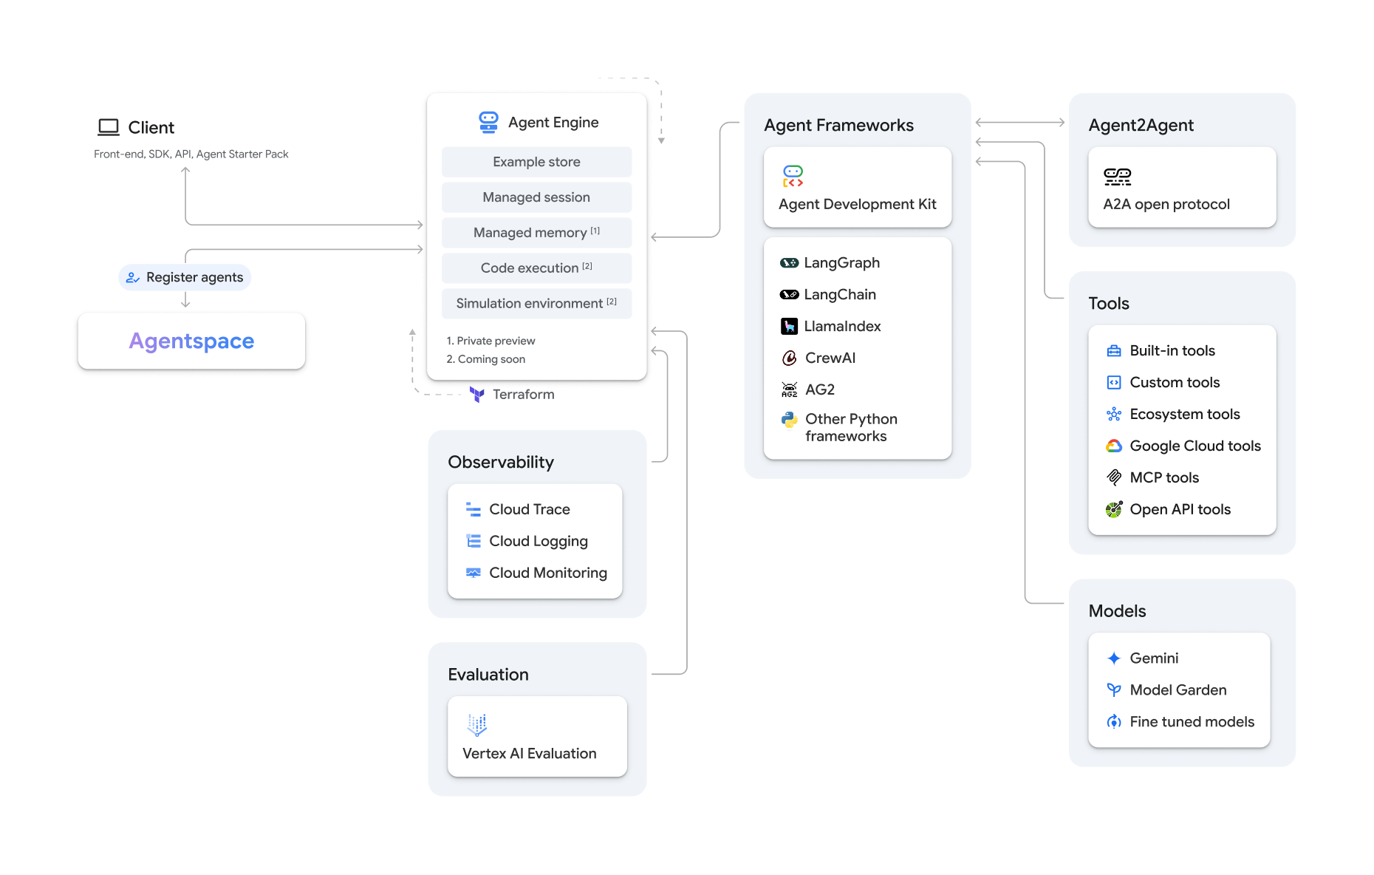
Trick #9: Don’t waste time in deploy!
Esra
Define an agent in a framework
Deploy to a fully provisioned runtime
Manage context: sessions, memory, examples
Observe agent behavior
Call your agent from your App/UI
Register your custom agent in Agentspace

Slide 21
Deploy to Vertex AI Agent Engine
from vertexai import agent_engines
remote_app = agent_engines.create(
agent_engine=root_agent,
requirements=[
"google-cloud-aiplatform[adk,agent_engines]",
]
)

Slide 22
Dev day blueprint: Applied tricks
Esra
Agent track | Tech tips and tricks
"Know What You Don't Know" | Agentic Evaluation + RAG. Use VertexAiRagRetrieval to search the learner's "student notes". Then, have a separate FactCheckAgent check if the "Next Best Study Plan" is factually grounded in the diagnostic results.
"Know What You Don't Know" | The "Hero" Stack: Full Orchestration. The StudyCoach agent is the master Orchestrator. It calls specialist sub-agents (like the DiagnosticAgent and PlanGeneratorAgent) as tools to build a complete, personalized plan.
"Create anywhere" | Generator-Critic Pattern. The CardGeneratorAgent translates highlighted text (e.g., "Krebs cycle") to "draft cards". The CardCriticAgent validates the cards' accuracy and format before showing them to the user.
"Create anywhere" | Deterministic Guardrails (Callbacks). The generate_cards action is gated by a before_tool callback in Python that checks if the len(highlighted_text) is too long before executing the tool.
"Study Sprint Coach" | A2A Protocol for Asynchronous Tasks. The agent's job isn't instant; it manages a stateful 15-minute "sprint". Model this with an async task that waits for user activity and the timer to report its status (e.g., "recommends a follow-up").
"Practice that Fits" | Orchestrator Pattern. A main LanguageTutor agent orchestrates two specialists: an EvaluationAgent (checks responses against the user's "known word sets") and a ConversationGenerator (creates contextual practice).

Slide 23
Esra
How to pitch ?

Slide 24
You've built
an amazing agent.
Now, can you show
anyone its value?
Esra

Slide 25
One Project,
One Big Idea, One Great story
Esra
💡

Slide 26
A Story for Every Agent
Esra
Agent track | The Pitch Narrative
"Know What You Don't Know" – Diagnostic Agent | "Every student faces the 'I don't know where to start' problem. This agent is the answer. It’s a smart diagnostic that instantly finds your knowledge gaps and builds the perfect study plan, turning friction into a clear path forward."
"Study Sprint Coach" - Adaptive Session Generator | "You have 15 minutes. Is that enough time to study? Our agent says 'yes.' It’s a personal coach that builds a high-efficiency, time-bound study sprint, turning every spare minute into a learning victory."
"Challenge Me" - Adaptive Difficulty & Mastery Agent | "The perfect study session is a 'flow state'—not too hard, not too easy. This agent is your guide. It adapts the difficulty in real-time, challenging you when you're confident and reviewing when you hit a wall, ensuring you're never bored or discouraged."
"Create anywhere" - Omnipresent creation experience | "Learning shouldn't be interrupted by tool-switching. This agent is an omnipresent assistant that brings the tools to you. Highlight a word, and it’s there, ready to create flashcards or quiz you—no page switching, zero friction."
"Practice that Fits" - Personalized Language Tutor Agent | "The hardest part of learning a language is finding someone to practice with. This agent is that partner. It’s a personalized tutor that builds conversations using the words you just learned, targeting your specific gaps so you can practice what you actually need to."

Slide 27
Start with a Hook, End with a Vision.
Esra
The Hook (Start with a Question)
Don't start with "Hi, we're Team X and we built...". Start with the problem.
Example for the "Know What You Don't Know" Agent: "What if you could turn that awful feeling of 'I don't even know where to start' into a personalized, targeted study plan in under 60 seconds?"
Introduce the Hero & The Dragon
Frame the problem using your chosen story strategy from the blueprint.
"That feeling of being overwhelmed is the 'Dragon' every student faces. Our agent is the 'Hero' that slays it by automating the initial study plan, turning confusion into a clear path."
The "Demo as Evidence"
Your demo is not the pitch. It is the proof that your story is true.
Show the single most impactful part of your agent that supports your narrative (e.g., show the agent asking 3 quick questions and then immediately producing the 'Next Best Study Plan' )..
The Vision (The "Why")
End by zooming out. Connect your solution to a bigger picture.
"This isn't just about a diagnostic test. This is about removing the single biggest point of friction in studying, and turning a student's anxiety into activation."
The Ask & The Close

Slide 28
Don't Just Build a Great Agent,
Tell a Great Story.
Esra
You used advanced patterns like Orchestrators and Guardrails to build a system that works.
But…
You used a proven narrative structure to build a pitch that lands.
Your technical architecture is the foundation that makes your story credible.
Your story is what makes your technical work compelling.

